Slide 1
Happily Ever After? Disability and Cure in Popular Romance Novels
Ria Cheyne
riacheyne@googlemail.com

Slide 2
Definitions: Romance Novel
A Central Love Story: The main plot centers around two individuals falling in love and struggling to make the relationship work. A writer can include as many subplots as he/she wants as long as the love story is the main focus of the novel.
An Emotionally-Satisfying and Optimistic Ending: In a romance, the lovers who risk and struggle for each other and their relationship are rewarded with emotional justice and unconditional love.
Romance Writers of America, “About the Romance Genre”

Slide 3
Definitions: Disability
(1) A person (P) has a disability if—
  (a)P has a physical or mental impairment, and
  (b)the impairment has a substantial and long-term adverse effect on P's ability to carry out normal day-to-day activities.
United Kingdom Equality Act 2010
“long-term” = lasting or likely to last 12 months

Slide 4
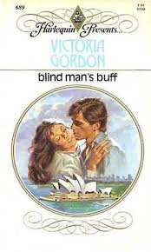
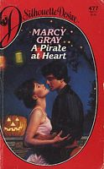



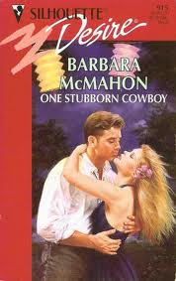
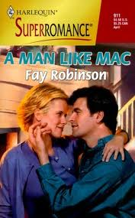

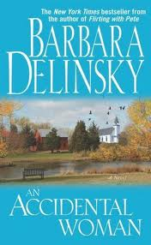
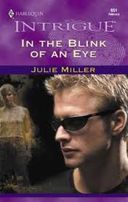



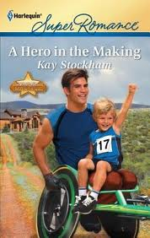
1982
2012

Slide 5
Disability and the Demand for Narrative
Disability “demands a story” (Michael Bérubé).
“In social relations, disabled bodies prompt the question, ‘What happened to you?’ The disabled body demands a narrative, requires an apologia that accounts for its difference from unexceptional bodies” (Rosemarie Garland Thomson).

Slide 6
If disability demands narrative...
...romance novels featuring disabled heroes or heroines demand narratives of cure.

Slide 7
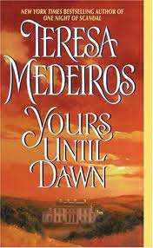

Actual Cure
“I’ll always limp, but then I’ll be almost as good as new” (185)

Slide 8

Actual cure
“She bandaged my wounds, mending them with her touch […] as she lay in my bed, she healed my eyes with her virtuous kiss”
“all know of the curative power of a virgin bride”

Slide 9
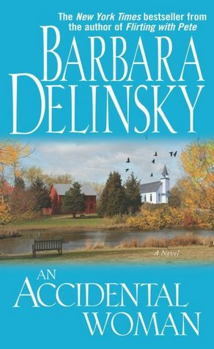
A Lot Like Cure

Slide 10

A Lot Like Cure
Marc placed his hands on the sides of the chair and bore down, using his arms to help his still-weak leg muscles bring him to his feet. He heard Fiona's gasp and remembered she’d never seen him stand. With halting, painful steps he slowly covered the distance between them, his gaze fixed on her, his greatest reward. (298)

Slide 11
Emotional healing
“Do you remember the night we first made love? Remember where you kissed me?”
“I kissed you everywhere you’d lie still for.”
“You kissed my leg. That was the first time in fifteen years that I’ve felt completely whole—as if what I don’t have doesn’t matter.”

Slide 12
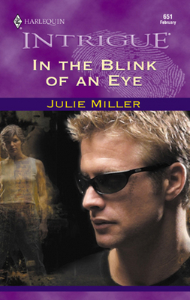
Displaced Healing
She was the healer here. She shouldn’t attach any significance to the warmth pouring into her body through the touch of his hands and mouth. She shouldn’t notice how those hurtful memories scattered and faded and were absorbed into the solid strength of his broad shoulders and the unhesitating sense of purpose in his kiss. (130)

Slide 13

Slippage
She had felt almost normal. There had even been moments when she had forgotten about her leg, and that hadn’t happened since waking up in the recovery room. She felt kind of tingly, almost like a limb regaining circulation after being in a cramped position. Part of her that had felt dead since the accident felt vibrantly alive. All because of a kiss. (88-9)

Slide 14
Literary Disability Studies
Literary Studies
Disability Studies

Slide 15
1982
2012

