Slide 1
Disability, Reflexive Representations and Genre Fiction
Ria Cheyne
Liverpool Hope University
riacheyne@googlemail.com

Slide 2
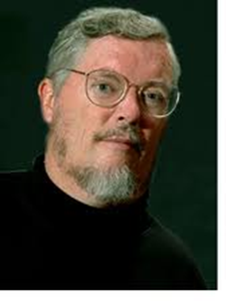
Disability Studies
the academic counterpart to disability rights advocacy. It aims to do the work of research and critical analysis necessary to any effort at social reconstruction. It critically analyses the ideas about disability that have shaped societal organization and public policies, cultural values, and architectural design, individual behavior and interpersonal encounters, professional training and delivery of services. (Longmore, Why I Burned My Book, 2).

Slide 3
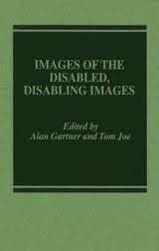
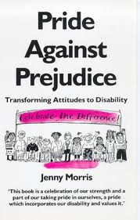
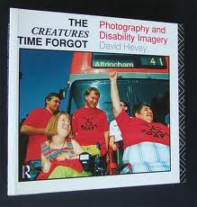
Cultural Strand
Longmore, “Screening Stereotypes” (1985)
Gartner and Joe, Images of the Disabled, Disabling Images (1987)
Zola, “‘Any Distinguishing Features?’” (1987)
Morris, Pride Against Prejudice (1991)
Barnes, Disabling Imagery and the Media (1992)
Hevey, The Creatures Time Forgot (1992)

Slide 4
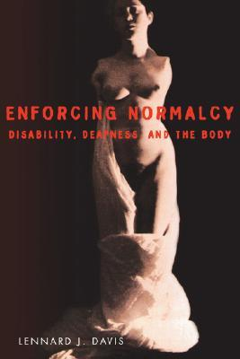
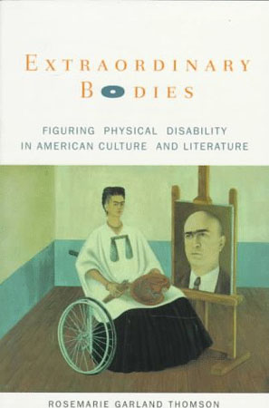
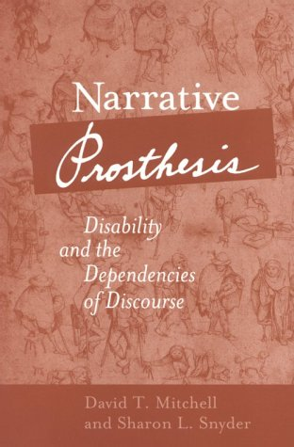
1995
1997
2000

Slide 5
Three claims
Evaluative approaches have never really gone away – only underground
The case against evaluative approaches has been overstated
Evaluative approaches still have much to contribute to cultural disability studies

Slide 6
Positive-image approaches: Representations…
“unsettle conventional notions of normality and disability” (Squier 71)
“necessitate interactions between reader and text that allow for fuller understanding of disabilities as they exist in relation to society” (Birge)
Offer “a nuanced take on the human body and its diverse forms” (Popp 37)

Slide 7
Evaluative Arguments
Jablonski [...] complicate[s] dominant understandings of disability, turning away from facile metaphorizations and instead developing depictions that interrogate disability identity’s complex relationship to the tradition of disability representation. (Hosey 37)
Collins’s writing of physical difference [...] constitutes an early comment on and a potentially transformative critique of those modern practices (and resulting cultural forms) which in their origin intend to define, designate, medicalize, control and exclude the body that is physically and cognitively different. (Mossman 483-484)
This essay […] demonstrate[s] how graphic fictions articulate the embodied, ethical, and sociopolitical experiences of impairment and disability. […] these graphic novels unsettle conventional notions of normality and disability. (Squier 71)

Slide 8
Critiques of negative/positive image approaches
Even images intended positively might have negative consequences.
Can’t classify a representation as positive or negative without understanding the historical context in which it was produced and received.
Different audiences will understand different portrayals differently
It might be fairly easy to identify negative images, but it’s much harder to agree on what a positive image might be.
(Paraphrasing Mitchell and Snyder, Narrative Prosthesis)

Slide 9
Critiques of negative/positive image approaches
Even images intended positively might have negative consequences.
Can’t classify a representation as positive or negative without understanding the historical context in which it was produced and received.
Different audiences will understand different portrayals differently
It might be fairly easy to identify negative images, but it’s much harder to agree on what a positive image might be.
(Paraphrasing Mitchell and Snyder, Narrative Prosthesis)

Slide 10
Critiques of negative/positive image approaches
Even images intended positively might have negative consequences.
Can’t classify a representation as positive or negative without understanding the historical context in which it was produced and received.
Different audiences will understand different portrayals differently
It might be fairly easy to identify negative images, but it’s much harder to agree on what a positive image might be.
(Paraphrasing Mitchell and Snyder, Narrative Prosthesis)

Slide 11
Critiques of negative/positive image approaches
Even images intended positively might have negative consequences.
Can’t classify a representation as positive or negative without understanding the historical context in which it was produced and received.
Different audiences will understand different portrayals differently
It might be fairly easy to identify negative images, but it’s much harder to agree on what a positive image might be.
(Paraphrasing Mitchell and Snyder, Narrative Prosthesis)

Slide 12
Reflexive Representations
Conceptualisation
Prejudice
Problematisation
Access

Slide 13
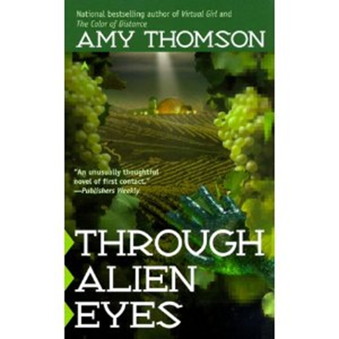
Conceptualisation
“Humans had accomplished a great deal, despite the immense handicaps they struggled under” (194).
Amy Thomson, Through Alien Eyes (1999)

Slide 14
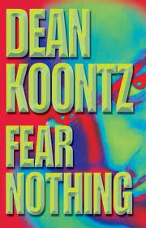
Prejudice
Dean Koontz, Fear Nothing (1997)
“some people feared and despised me more than they would fear or despise a three-eyed Toad Man in any carnival freak show” (297)
“So many thoughtless people have made unkind assumptions about me, based on my appearance and my affinity for the night, that I am reluctant to join the club of cruelty” (38)

Slide 15

Problematisation
“Megan Galloway had broken her neck while still in her teens. She became part of the early development of a powered exoskeleton, research that had led to the hideously expensive and beautiful Golden Gypsy, of which only one was ever built. It abolished wheelchairs and crutches for her. It returned her to life, in her own mind, and it made her a celebrity” (380)
“The world was briefly treated to the sight of quadriplegics dominating a new art form” (380)

Slide 16

Problematisation
John Varley, “Tango Charlie and Foxtrot Romeo” (1986)
“Bach had thought her cure was complete, but now she wondered. Galloway carried a beautiful crystal cane. It didn’t seem to be for show. She leaned on it heavily, and made her way through the tables slowly” (380-381)

Slide 17
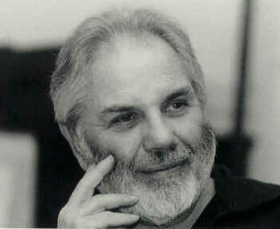
Access
Zola on crime fiction:
“Soon, some protagonist with a limp, a ‘touch’ of emphysema or arthritis, or a missing limb will confront a long flight of stairs without a banister and will mutter, ‘God dammit, how I hate stairs!’” (246)

Slide 18
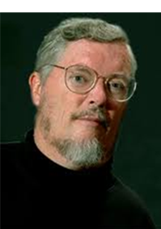
Reflexive Representations and Relearning
“Disability” is not what most of us commonly think it is. People with disabilities are not who or what we have been taught to assume they are. The experience of disability is not what we have been told. Most of the conventional wisdom about disabled people is wrong. […] All of us, disabled and nondisabled alike, will never truly understand disability experiences and identities unless we examine what we think we know. We all have a lot of relearning to do. (Longmore, Why I Burned My Book, 13-14).

