Slide 1
Disability, Affect and Genre Fiction
Ria Cheyne, Liverpool Hope University
cheyner@hope.ac.uk
riacheyne.net
@riacheyne

Slide 2
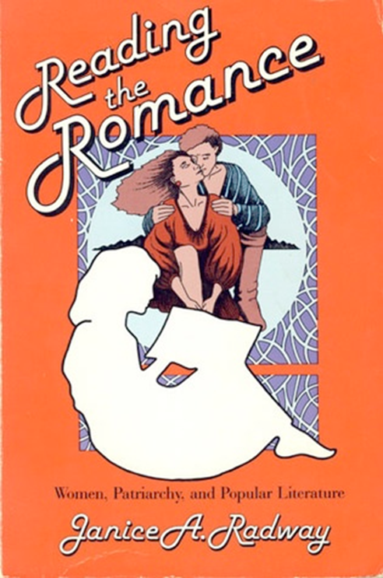
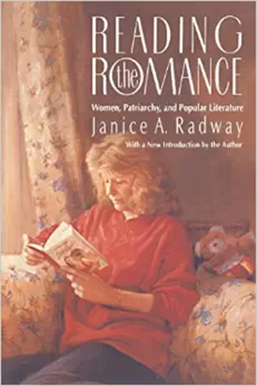
Reading the Romance
Joy […] mentioned in her discussion of “bad romances” that while “perfection’s not the main thing,” she still hates to see an author “dwelling on handicaps or disfigurements.” “I find that distasteful and depressing,” she explained. (98)

Slide 3
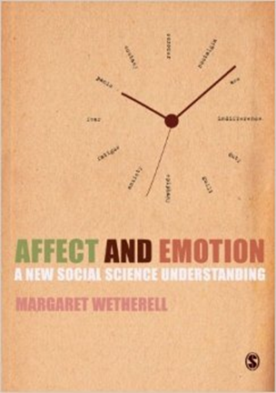
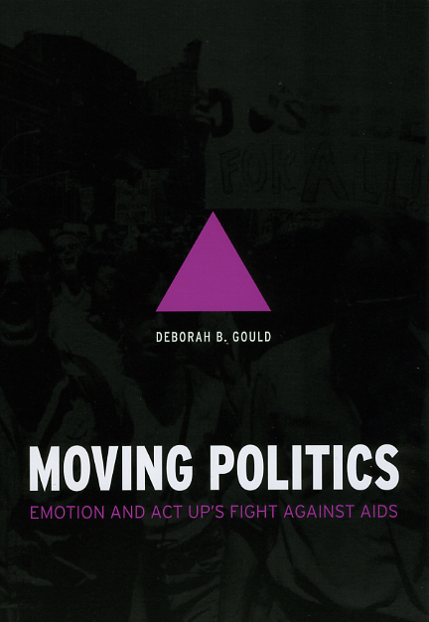
Affect
Post-2000 ‘affective turn’
Emotional/physiological/ cognitive
Radical, transformative potentials.

Slide 4
Genre Fiction and Affect
‘reading with feeling’ (Feagin)
Adept at securing desired affective responses
Desire to experience a particular kind of feeling as underpinning motivation for genre fiction reading.

Slide 5
Genre Fiction and Affect
Theory of affective intent.
Attempt to attribute genre based on the ‘emotional disposition of the specific reader/viewer’ ‘misses the fact that audiences (and critics, for that matter) may evaluate entirely non-scary horror texts as “bad” or “failed” horror, but as horror nonetheless’ (Hills, The Pleasures of Horror 34).
Horror is the feeling the genre ‘characteristically or rather ideally promotes’ (Carroll, The Philosophy of Horror 14).

Slide 6
Reading the Romance
Joy […] mentioned in her discussion of “bad romances” that while “perfection’s not the main thing,” she still hates to see an author “dwelling on handicaps or disfigurements.” “I find that distasteful and depressing,” she explained. (98)

Slide 7
Disability Affects
‘the disabled body and mind always elicit powerful emotions’ (Siebers, Disability Aesthetics 10).
Disability makes us feel.
Affect is useful for thinking about disability:
  Generative vocabulary
  Expresses complexity of feelings
  Not ‘just’ of mind, or ‘just’ of body

Slide 8
Inheritance of literary disability studies
Literary studies: suspicion of emotive/sensational texts.
DS: suspicion of (excessive) emotion, focus on ‘negative’ emotions.
Elizabeth J. Donaldson and Catherine Prendergast call for scholars to ‘push the analysis of the emotional in Disability Studies further’ (130).
Orlando: work on emotion and affect in DS ‘often call[s] attention to the presence or influence of negative affect’ (102).
Binary thinking.

Slide 9
Genre and Disability
Disability only one part of larger affective system.
Reminds us of complexity of disability affects.
Reflecting on affects.

Slide 10
Reading the Romance
Joy […] mentioned in her discussion of “bad romances” that while “perfection’s not the main thing,” she still hates to see an author “dwelling on handicaps or disfigurements.” “I find that distasteful and depressing,” she explained. (98)

