Slide 1
Science Fiction, Disability, and Disability Studies: A Short Introduction
Ria Cheyne, Liverpool Hope University
cheyner@hope.ac.uk
riacheyne.net
@riacheyne

Slide 2
Structure
What is Disability Studies?
  Core concepts and ideas
  Cultural Disability Studies
Disability in SF: a very brief history
Critical engagements
Why should we care?
Bujold’s Vorkosigan series
Suggested critical and fictional works.

Slide 3
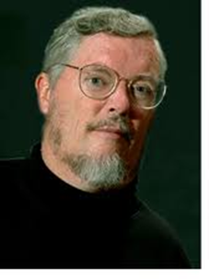
Disability Studies is…
the academic counterpart to disability rights advocacy. It aims to do the work of research and critical analysis necessary to any effort at social reconstruction. It critically analyses the ideas about disability that have shaped societal organization and public policies, cultural values, and architectural design, individual behavior and interpersonal encounters, professional training and delivery of services. (Paul Longmore, Why I Burned My Book, 2).

Slide 4
Disability Studies
Views disability as a different way of being in the world rather than as inherently involving loss or deficiency
Recognises that disabled people continue to face significant barriers
Aims to challenge negative perceptions of disability
Is about a particular ideology – not just ‘studying disability’
Trying to change the world – or produce knowledge that might help…

Slide 5
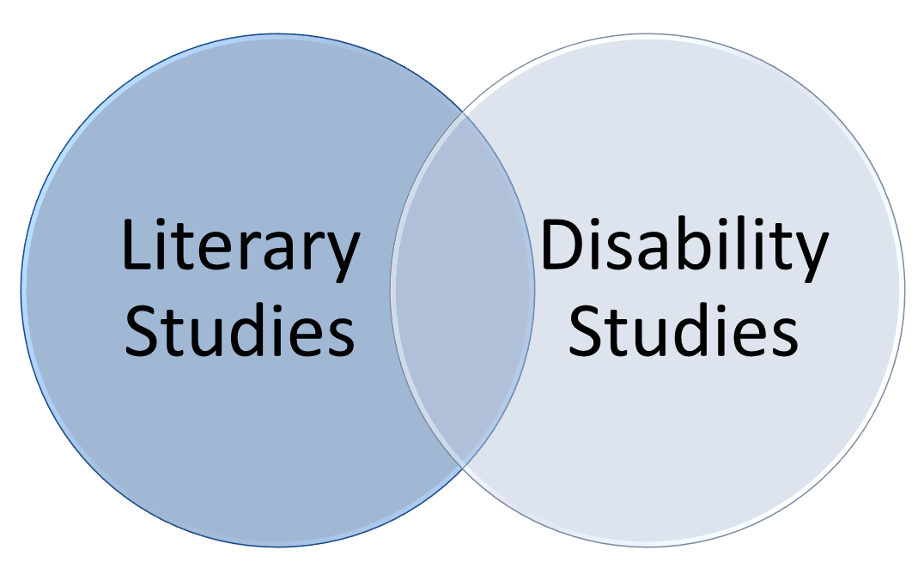
Literary Disability Studies
Analyse representations of disability in literature for:
  what they might reveal about a disabling society
  new insights into texts (and genres)
Me

Slide 6
Assumptions
Starting point: representations reflect and shape attitudes towards disability
“Readers and viewers find their own personal interpretations of disability inevitably influenced by their imaginative encounters with disabled people in fictional works” (Mitchell and Snyder, Narrative Prothesis 42).
Caveat: representations and their effects are complex.

Slide 7
Key Concepts
Social Model of Disability
Extraordinary Bodies
Normalcy/‘the normal’
Ableism/disablism
Want to know more?
Leeds Centre for Disability Studies Archive: open-access repository of scholarly and activist writings http://disability-studies.leeds.ac.uk/library/
Disability Studies Quarterly: open-access Disability Studies journal http://dsq-sds.org/index
Naomi Jacobs collects a useful set of introductory readings at https://naomijacobs.wordpress.com/disability-studies-a-very-short-introduction/

Slide 8
Brief Timeline of Disability in SF
1904 | H.G. Wells, ‘The Country of the Blind’
1944 | C.L. Moore, ‘No Woman Born’
1948 | Judith Merril, ‘That Only a Mother’
1951 | John Wyndham, The Day of the Triffids
1957 | Poul Anderson, ‘Call Me Joe'
1968 | Philip K. Dick, Do Androids Dream of Electric Sheep?
1969 | Anne McCaffrey, The Ship Who Sang
1976 | Marge Piercy, Woman on the Edge of Time
1985 | Kim Stanley Robinson, The Memory of Whiteness
1985 | Lois McMaster Bujold, The Warrior’s Apprentice
1990 | Greg Bear, Queen of Angels
1991 | Orson Scott Card, Xenocide
2003 | Elizabeth Moon, The Speed of Dark

Slide 9
‘the genre of science fiction is as obsessed with disability as it is with space travel and alien contact’ (568)
Michael Bérubé, ‘Disability and Narrative’, PMLA 120 (2005): 568-76

Slide 10
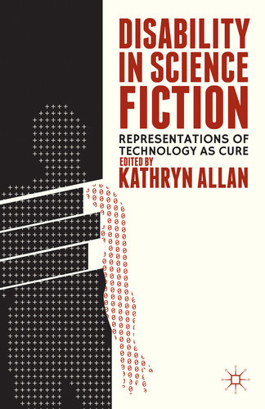
Scholarship
Key step in field-building
Aimed to be accessible to SF fans

Slide 11
SF and Disability
SF a ‘promising but complicated site for explorations of disability’ (Tidwell in Allan, 167).
‘While the settings and temporal framework of SF may differ dramatically from our own current reality, the way in which disability and people with disabilities are represented […] often directly represents present-day biases and stereotypes’ (Allan 3).

Slide 12
Potentials
Science fiction “is a discourse that allows us to concretely imagine bodies and selves otherwise” (Sherryl Vint, Bodies of Tomorrow: Technology, Subjectivity, Science Fiction, 2007)
“by imagining strange worlds we come to see our own conditions of life in a new and potentially revolutionary perspective” (Patrick Parrinder, “Introduction: Learning from Other Worlds” in Learning From Other Worlds: Estrangement, Cognition, and the Politics of Science Fiction and Utopia, 2000)

Slide 13
SF can…
Depict alternative worlds with alternative conditions (social model)
Explore questions about the ethical use of technology – e.g. to eliminate or create disability
Challenge accepted notions of ‘ability’ and ‘disability’
Disrupt understandings of disability as an absolute category
Depict genuinely ‘extraordinary bodies’ – difference not deviance
…in the context of a popular literary form.

Slide 14
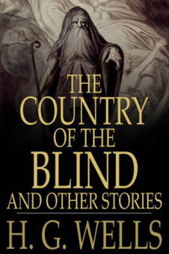
Alternative Environments
Wells, ‘The Country of the Blind’ (1904)
‘It was marvellous with what confidence and precision they went about their ordered world. Everything, you see, had been made to fit their needs; each of the radiating paths of the valley area had a constant angle to the others, and was distinguished by a special notch upon its kerbing; all obstacles and irregularities of path or meadow had long since been cleared away’

Slide 15
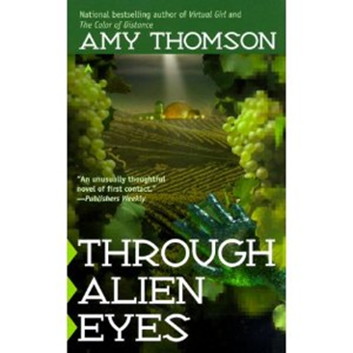
Challenging Norms
‘Humans had accomplished a great deal, despite the immense handicaps they struggled under’ (194).
Amy Thomson, Through Alien Eyes (1999)

Slide 16

Challenging Negative Associations
John Varley, ‘Tango Charlie and Foxtrot Romeo’ (1986)
‘The world was briefly treated to the sight of quadriplegics dominating a new art form’ (380)

Slide 17
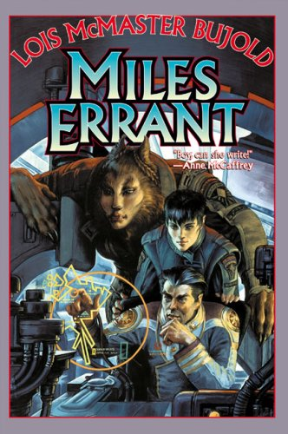
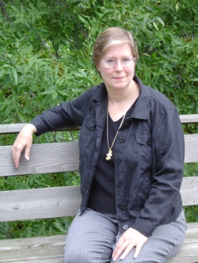
Lois McMaster Bujold

Slide 18
Miles not curable
‘Years of arcane medical tortures had almost managed to correct the severe deformities from which Miles had nearly died at birth. Almost. Curled like a frog in infancy, he now stood almost straight. Chalk-stick bones, friable as talc, now were almost strong. Wizened as an infant homunculus, he now stood almost four-foot-nine.’ (The Vor Game 471)

Slide 19
Miles: Cognitive Exceptionality
‘Miles thinks he’s a knight-errant. A rational government wouldn’t allow him possession of a pocket-knife, let alone a space fleet’ (Mirror Dance 473).
‘we are discussing a young man upon whom [the planet] Barrayar laid so much unbearable stress, so much pain, he created an entire other personality to escape into. He then persuaded several thousand galactic mercenaries to support his psychosis, and on top of that conned the Barrayaran Imperium into paying for it all. […] I grant you he’s a genius, but don’t you dare try to tell me he’s sane’ (Mirror Dance 473)

Slide 20
Mirror Dance (1994)
The Black Gang:
  Howl (pain)
  Gorge (force-feeding)
  Grunt (sexual abuse)
  The Other

Slide 21
Mirror Dance (1994)
‘Gorge and Grunt and Howl and the Other had sent Lord Mark deep inside, to sleep through it all. Poor, fragile Lord Mark, barely twelve weeks old.
Ryoval could not even see Lord Mark down in there. Could not reach him. Could not touch him. Gorge and Grunt and Howl and the Other were all very careful not to wake the baby. Tender and protective, they defended him. They were equipped to.’ (665)

Slide 22
Mirror Dance (1994)
‘He could make a thousand of them, at need. He was an army, flowing round obstacles, impossible to destroy with any one cut’ (680).
‘Sometimes, insanity is not a tragedy. Sometimes, it’s a strategy for survival. Sometimes . . . it’s a triumph’ (720).
‘they all ran together, he and the black gang, on the deepest level. No part could be excised without butchering the whole. So, I’ll just have to look after you all’ (740).

Slide 23
Science Fiction Potentials
‘By presenting alternatives, the fantastic throws into relief the “real.” Because works of the fantastic are simultaneously situated both within the writer's realm (and thus subject to the codes and conventions of the time in which they are written), and within the realm of the imaginary worlds constructed, they can both reenact and alter racial codes and representations.’ (Elisabeth Anne Leonard, Into Darkness Peering: Race and Color in the Fantastic 4)

Slide 24
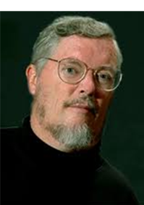
Relearning
“Disability” is not what most of us commonly think it is. People with disabilities are not who or what we have been taught to assume they are. The experience of disability is not what we have been told. Most of the conventional wisdom about disabled people is wrong. […] All of us, disabled and nondisabled alike, will never truly understand disability experiences and identities unless we examine what we think we know. We all have a lot of relearning to do. (Longmore, Why I Burned My Book, 13-14).

Slide 25
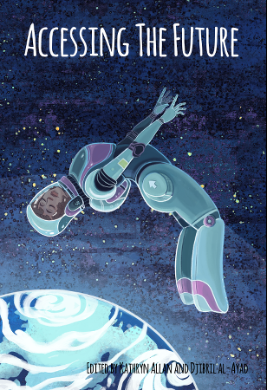
You might want to try…
C.S. Friedman, This Alien Shore
Peter Watts, ‘Rifters’ trilogy
Theodore Sturgeon, More Than Human
Jacqueline Koyanagi, Ascension
John Wyndham, The Chrysalids
Philip K. Dick, Martian Time-Slip
Greg Egan, Distress
Kathryn Allan and Diibril al-Ayad (eds), Accessing the Future
Lois McMaster Bujold, Falling Free

Slide 26
Want to know more?
Jane Stemp, ‘Devices and desires: science fiction, fantasy and disability in literature for young people’ http://dsq-sds.org/article/view/850/1025
Bleeding Chrome, Kathryn Allan’s blog: http://www.academiceditingcanada.ca/blog
Ria Cheyne, ‘“She was born a thing”: Disability, the Cyborg and the Posthuman in Anne McCaffrey’s The Ship Who Sang’ http://www.jstor.org/stable/10.2979/jmodelite.36.3.138?seq=1#page_scan_tab_contents and “Disability and Popular Fiction: Reading Representations” http://online.liverpooluniversitypress.co.uk/doi/abs/10.3828/jlcds.2012.11 [both paywalled - email me!]
Special Needs in Strange Worlds column at SF Signal http://www.sfsignal.com/archives/category/columns/special-needs-in-strange-worlds/

