Slide 1
The Romantic Impairment: PTSD in Contemporary Romance
Ria Cheyne, Liverpool Hope University
riacheyne@googlemail.com
riacheyne.net
@riacheyne

Slide 2
Structure
Locating this research
Romance novels
Disability in Romance Novels
PTSD as romantic impairment
Potentials and Problems
A Counter-Example: Ruth Wind, Reckless (1997)
Conclusion

Slide 3
Locating My Work
Analyse representations of disability in literature for:
  what they might reveal about a disabling society
  new insights into texts (and genres)
Focus on representations of disability in contemporary popular fiction, particularly genre fiction
Interested in texts circulating in culture and the effects they have
Starting point: representations reflect and shape attitudes towards disability
Caveat: representations and their effects are complex
Not interested in reading as therapy or writing as therapy

Slide 4
(Critical) Medical Humanities?
Literary Studies
Disability Studies
Me

Slide 5
The Romance Novel
A Central Love Story: The main plot centers around individuals falling in love and struggling to make the relationship work. A writer can include as many subplots as he/she wants as long as the love story is the main focus of the novel.
An Emotionally Satisfying and Optimistic Ending: In a romance, the lovers who risk and struggle for each other and their relationship are rewarded with emotional justice and unconditional love.
Romance Writers of America, http://www.rwa.org/p/cm/ld/fid=578

Slide 6
Romance
Most popular of popular genres – consistently c. 13% of US consumer book market sales
$1.08 billion sales in 2013 (RWA)
‘the most popular, least respected’ literary genre (Regis, A Natural History of the Romance Novel)

Slide 7
Disability in Romance: General Trends
Hero rather than heroine
Disabled hero/heroine with nondisabled partner
Acquired rather than congenital
Focus on particular impairments

Slide 8
Disability in Romance: General Trends
Narratives of curing/healing/overcoming
  Actual cure
  Pseudo cure
  Emotional/psychological wounds
  Sexual healing
Romantic partner as agent of cure.

Slide 9
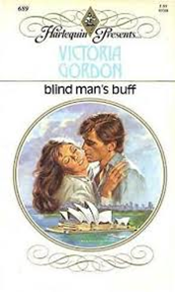
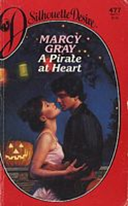
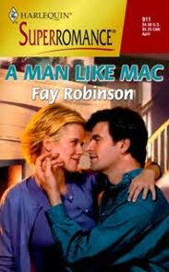


The Romantic Impairment
Common impairments in romance novels:
1. visual impairment
2. spinal cord injury/lower limb paralysis
3. limp, scarring, amputation.

Slide 10
The Romantic Impairment
Acquired doing something heroic or self-sacrificing
Does not affect the hero’s ability to be athletic, powerful, or successful
Does not diminish the hero’s attractiveness, to heroine or other women
Does not involve incontinence, pain, or fatigue
Often turns out to be curable.

Slide 11
S.E. Smith: ‘In pop culture, [PTSD] seems to have become the stuff of romance’ http://meloukhia.net/2014/01/ptsd_is_not_romantic_or_sexy/
‘P.T.S.D.(esire)’ http://bookclubs.barnesandnoble.com/t5/Unabashedly-Bookish-The-BN/P-T-S-D-esire/ba-p/378523

Slide 12
PTSD as Romantic Impairment
Usually associated with veterans = heroism, self-sacrifice
Military service = fitness, athleticism.
Invisible
Limited range of symptoms presented
Symptoms generally decreased (sometimes cured) by end of novel.

Slide 13
The Appeal of PTSD
Regis on romance: ‘The novel chronicles the heroine’s taming of the dangerous hero or her healing of the injured hero, or both’ (206).
Multiple and interlinked healing processes.
Tanner: ‘In the romance novel interpretation of PTSD, it has an identifiable cause (i.e.: a traumatic event) and this cause is wholly external (i.e.: the character is not “abnormal” or a “freak”). PTSD permits a military hero to show some vulnerability without appearing weak’ (‘Romance Novels and Depression: A Taboo Topic?’ http://www.monkeybearreviews.com/2009/12/17/romance-novels-and-depression-a-taboo-topic/).

Slide 14
The Appeal of PTSD
‘Romance readers can always expect a big emotional payoff when a tortured hero finds an everlasting romance with the right woman’
Julie Naughton, ‘In Love and War: Romance Books, 2013’ http://www.publishersweekly.com/pw/by-topic/new-titles/adult-announcements/article/59947-in-love-and-war-romance-2013.html

Slide 15
Problems and Potentials of PTSD Representation
Awareness, empathy, understanding
Focus on certain ‘romantic’ symptoms while marginalising others
Misleading impression of ease of recovery: ‘For some bizarre reason, the PTSD sufferers in these stories seem to undergo a full recovery by the end of the book. Love conquers all, I suppose’ (Tanner).
Reinforce problematic notion of healing through love/loved one as agent of cure. ‘Healing is done by survivors, not to survivors’ (Shay, Achilles in Vietnam 187).

Slide 16
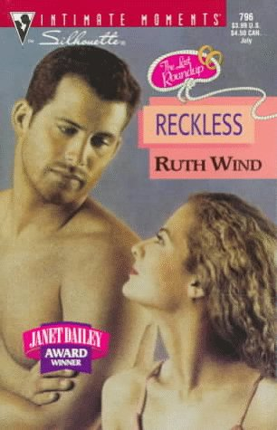
Ruth Wind, Reckless (1997)
Hero and heroine with PTSD
Wider range of symptoms
Ramona rejects role of healer: ‘I can love you […] but I can’t heal you’ (242)
‘She couldn’t […] slay his dragons for him. He had to do it himself’ (243)
No easy cure, lasting effects

Slide 17
Conclusions
Medics/therapists need to be aware of these narratives and how they might shape a person’s experience of PTSD
Dominant cultural narratives – risk of violence for those whose symptoms do not fit
Conditions of production and consumption
Reader engagement with texts is complex. Potential in happily ever after?

