Slide 1
What is Normal? Cognitive Exceptionality and Science Fiction
Ria Cheyne
riacheyne@googlemail.com
riacheyne.net
@riacheyne

Slide 2
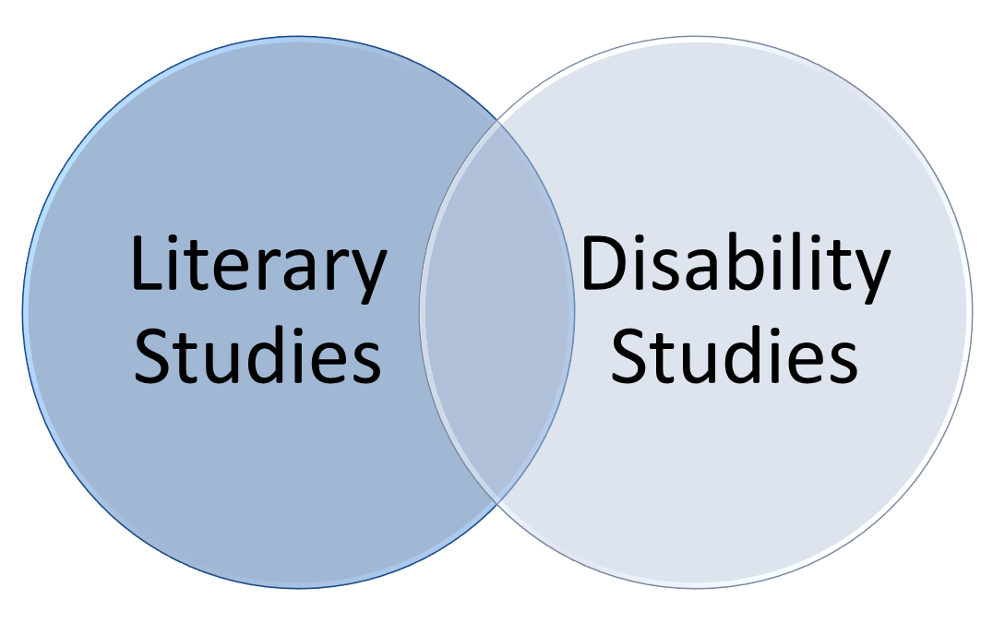
Literary Disability Studies
Analyse representations of disability in literature for:
  what they might reveal about a disabling society
  new insights into texts (and genres)
Me

Slide 3
Assumptions
Starting point: representations reflect and shape attitudes towards disability
“Readers and viewers find their own personal interpretations of disability inevitably influenced by their imaginative encounters with disabled people in fictional works” (Mitchell and Snyder 42).
Caveat: representations and their effects are complex.

Slide 4
Science Fiction
Relatively few restrictions
Potential for alternative normative system
Simultaneously marginalised and privileged.

Slide 5
Science Fiction Potentials
By presenting alternatives, the fantastic throws into relief the “real.” Because works of the fantastic are simultaneously situated both within the writer's realm (and thus subject to the codes and conventions of the time in which they are written), and within the realm of the imaginary worlds constructed, they can both reenact and alter racial codes and representations. (Leonard 4)

Slide 6
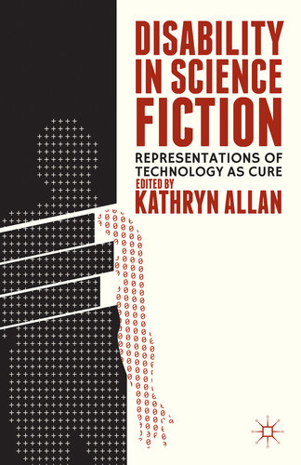
Scholarship
Key step in field-building
Aimed to be accessible to SF fans
Critical avoidance?

Slide 7
Science Fiction and Cure
‘While the settings and temporal framework of SF may differ dramatically from our own current reality, the way in which disability and people with disabilities are represented […] often directly represents present-day biases and stereotypes’ (Allan 3).
Cure narratives.
‘Nearly every culture views disability as a problem in need of a solution’ (Mitchell and Snyder 47).

Slide 8
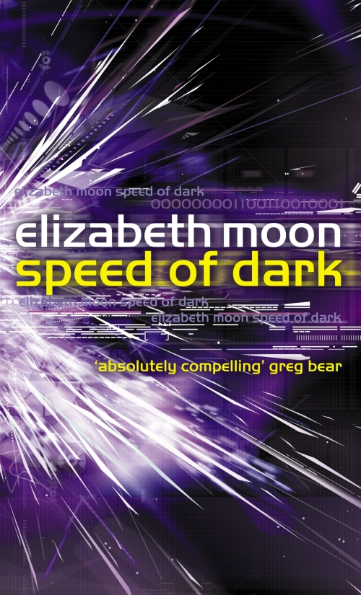

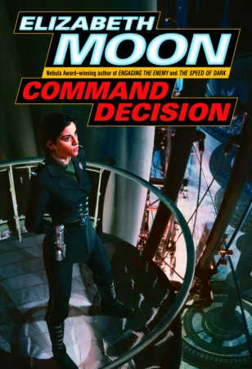
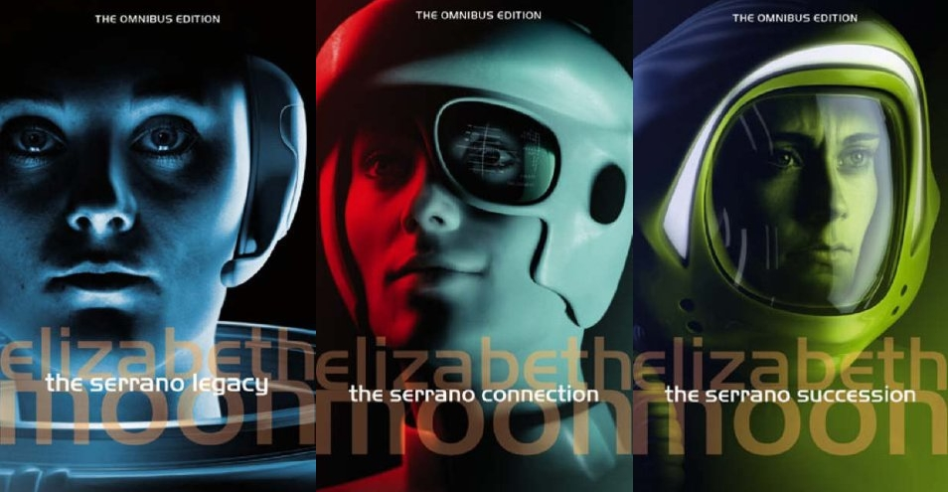
Moon

Slide 9
Once A Hero (1997)
‘they’ll throw me out…a mutineer who hid craziness in her past’ (location 5968)
‘damning check marks on a laundry list of mental illness that would bar her forever from anything she wanted to do’ (location 6008).
‘nightmares are not a symptom of insanity. Something awful happened to you; you had nightmares about it: a normal reaction. But your family tried to pretend it hadn’t happened, and that your normal nightmares were the real problem. That’s a failure to face reality – and being out of touch with reality is a symptom of mental illness’ (location 6102).

Slide 10
Rules of Engagement (1998) and Change of Command (1999)
‘A child’s defects reflected parental sin’ (Rules location 6450).
‘there’s no need to “fix” Simplicity’ (Change location 527).

Slide 11
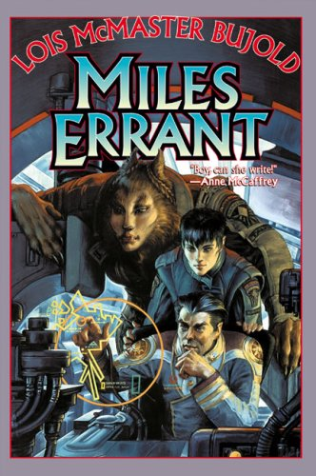

Lois McMaster Bujold

Slide 12
Miles not curable
Years of arcane medical tortures had almost managed to correct the severe deformities from which Miles had nearly died at birth. Almost. Curled like a frog in infancy, he now stood almost straight. Chalk-stick bones, friable as talc, now were almost strong. Wizened as an infant homunculus, he now stood almost four-foot-nine. (The Vor Game 471)

Slide 13
Mirror Dance (1994)
The Black Gang:
  Howl (pain)
  Gorge (force-feeding)
  Grunt (sexual abuse)
  The Other

Slide 14
Mirror Dance (1994)
Gorge and Grunt and Howl and the Other had sent Lord Mark deep inside, to sleep through it all. Poor, fragile Lord Mark, barely twelve weeks old.
Ryoval could not even see Lord Mark down in there. Could not reach him. Could not touch him. Gorge and Grunt and Howl and the Other were all very careful not to wake the baby. Tender and protective, they defended him. They were equipped to. (665)

Slide 15
Mirror Dance (1994)
‘He could make a thousand of them, at need. He was an army, flowing round obstacles, impossible to destroy with any one cut’ (680).
‘Sometimes, insanity is not a tragedy. Sometimes, it’s a strategy for survival. Sometimes . . . it’s a triumph’ (720).
‘they all ran together, he and the black gang, on the deepest level. No part could be excised without butchering the whole. So, I’ll just have to look after you all’ (740).

Slide 16
Miles’s abnormal mind
‘“My God,” he said hollowly, “you mean he’s like that all the time?”’ (The Warrior’s Apprentice 119).
‘some other kind of crazy’ (The Vor Game 783).
Fear of ‘incipient psychosis’ in Brothers in Arms (69).
‘Was his subconscious trying to tell him something? Well, he didn’t suppose he was in real trouble until a brain scan taken of him in his two different uniforms produced two different patterns’ […] ‘the idea was suddenly not funny’ (Brothers in Arms 121).

Slide 17
Miles’s Abnormal Mind
‘Miles thinks he’s a knight-errant. A rational government wouldn’t allow him possession of a pocket-knife, let alone a space fleet’ (Mirror Dance 473).
‘we are discussing a young man upon whom Barrayar laid so much unbearable stress, so much pain, he created an entire other personality to escape into. He then persuaded several thousand galactic mercenaries to support his psychosis, and on top of that conned the Barrayaran Imperium into paying for it all. […] I grant you he’s a genius, but don’t you dare try to tell me he’s sane’ (Mirror Dance 473).

Slide 18
Mark and Miles
‘One, two. Three, four, five, six, seven. Lord Miles Vorkosigan and Admiral Naismith. Lord Mark Vorkosigan and Gorge, Grunt, Howl, and Killer’ (Mirror Dance 739).

