Slide 1
The Blindman in the Romance Novel: Jane Eyre and the Representation of Visual Impairment
Ria Cheyne, Liverpool Hope University
riacheyne@googlemail.com
riacheyne.net

Slide 2
Background and Context
English Literature
Disability Studies
Literary disability studies: examines literary representations of disability to better understand both disability and literature.

Slide 3
Disability Studies
Activist origins
Disability not a tragedy – different way of being
Negative attitudes play central role in ‘disabling’ people who have certain bodily differences.

Slide 4
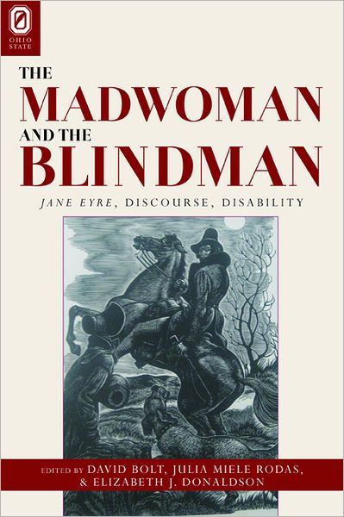

Slide 5
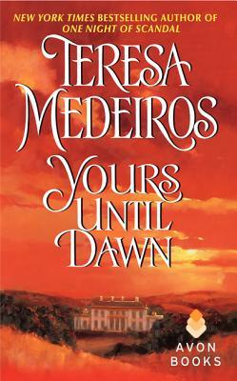
Influence of Jane Eyre
Schwab: ‘The dark hero of modern romance can be traced back to nineteenth-century fiction, in particular to Heathcliff and Rochester […] romance authors often include impliclit or explicit references to the Brontës’ novels in their own works’ (277)

Slide 6
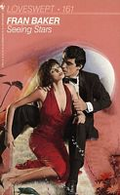
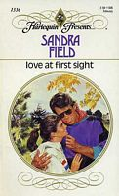
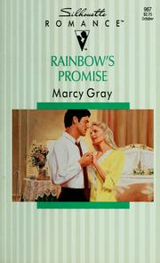
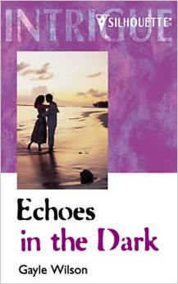
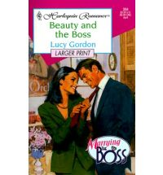
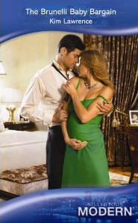

Slide 7
Jane Eyre and Disability
Undiminished masculinity
The disabled hero as unworthy of the heroine’s love
Care and dependence
Cure

Slide 8
Undiminished Masculinity
Symbolic castration? ‘an interpretive gesture so widely disseminated and consumed that it has come to represent the foundational meaning of blindness in Jane Eyre, despite the apparent contradiction of Rochester’s happy and fruitful marriage’ (Rodas, Donaldson, and Bolt 2)
‘not in one year’s space, by any sorrow, could his athletic strength be quelled, or his vigorous prime blighted’ (479).

Slide 9
‘I am not worthy’
‘You should care, Janet: if I were what once I was, I would try to make you care – but – a sightless block!’ (484)
‘what right would that ruin have to bid a budding woodbine cover its decay with freshness?’ (493)

Slide 10
‘I am not worthy’
‘Jane, will you marry me?’
‘Yes, sir.’
‘A poor blind man, whom you will have to lead about by the hand?’
‘Yes, sir.’
‘A crippled man, twenty years older than you, whom you will have to wait on?’
‘Yes, sir.’
  ‘Truly, Jane?’
‘Most truly, sir.’ (494)

Slide 11
Care and dependence
‘You are no ruin, sir – no lightning-struck tree: you are green and vigorous. Plants will grow about your roots, whether you ask them or not […] as they grown they will lean towards you, and wind round you, because your strength offers them so safe a prop.’ (493)

Slide 12
Cure
‘He cannot now see very distinctly: he cannot read or write much; but he can find his way without being led by the hand: the sky is no longer a blank to him – the earth no longer a void.’ (501)

Slide 14
Masculinity
‘You just happen to be the most attractive man I have ever met’ (Love at First Sight 58).
‘an aura of raw sexuality that made it impossible for a person to relax in his company’ (The Brunelli Baby Bargain 26)
‘Look at that super-sexy man!’ (Beauty and the Boss 59)

Slide 15
I am not worthy
Rainbow’s Promise: ‘He must have been delusional to think she would marry him. He was blind!’ (137).
Seeing Stars: ‘Are you attracted to me because I’m blind and you see me as someone who needs you to take care of him?’ (164)
Love at First Sight: ‘So you don’t think blindness is a barrier to any kind of a normal relationship? […] Then you don’t know anything about it’ (37).

Slide 16
Care and dependence
Love at First Sight: ‘If you consider it dependency, maybe that’s what it turns into. Look at it another way, Bryden—each of us had an enjoyable run’ (57).

Slide 17
The hero as saviour/protector
Seeing Stars: ‘his quick action had saved her life’ (38).
Love at First Sight ‘the other night when I came over here to punch out the burglars I realised I was helping you, and not the reverse. You don’t know how good it felt, to be of use to someone else—I’d figured my days for that were over’ (81).
Love at First Sight: ‘You’re giving me the chance to prove what a big strong man I am’ (135).

Slide 18
The Independent Hero
‘Your ideas of blindness come out of the nineteenth century. I have a computer that talks to me, a first-rate secretary, and a mind that remembers everything’ (Beauty and the Boss 44)

Slide 19
Conclusions
Themes and motifs from Jane Eyre very much present in contemporary texts.
Disability as individual problem, social element ignored.
Difficulty in depicting/imagining non-dependent or non-hierarchical relationship.

Slide 20
Conclusions
Eric S. Rabkin on genre definitions: characteristic, paradigmatic, operational, and social.
Jane Eyre as prototype for depictions of disability in contemporary romance novels.

